Slide 1
Chapter 8
Engineering Themes

Slide 2
Legacy systems
Originally developed as early as the 1960s and 1970s, some of them are likely to be high-volume transactions processing applications running on mainframe computers – commercial systems frequently written in the Cobol programming language using structured files rather than database systems. With high maintenance costs, use of obsolete hardware and software, poor documentation, changes in the real-world situation and lack of people support with the knowledge required to maintain them.

Slide 3
Software engineering
Software engineering concerns the use of
sound engineering principles, good
management practice, applicable tools,
and methods for software development.

Slide 4
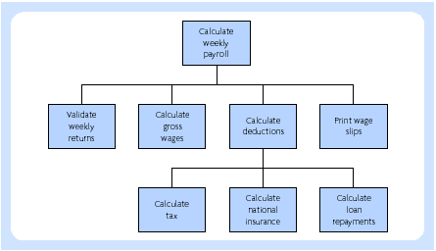
Functional decomposition

Slide 5
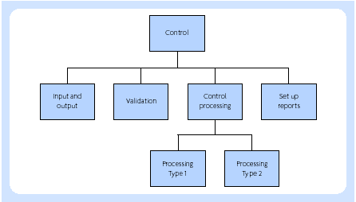
Program design

Slide 6
Automated tools
Graphical facilities for modelling and design
Data dictionary
Automated documentation
Code generation from systems specification or from the models designed using the tool
Automatic audit trail of all changes
Critical path scheduling with resource availability (i.e. project control)
Automatic enforcement of the standards of a chosen software development methodology

Slide 7
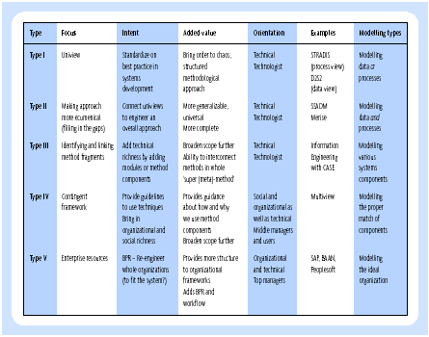
Method engineering

Slide 8
Component development
“Component is a physical packaging
of executable software with a well-
defined and published interface”
(Hopkins, 2000)

Slide 9
Security issues
Data accuracy may be ensured through thorough software validation routines and testing procedures
Confidential data such as credit card details in an Internet application might be encrypted
Access to information might be password protected
Security software might be in place to provide a firewall and virus protection (for example, using the Norton suite of programs)
Employee access to data is usually limited on a strict ‘need to know’ basis
Software and hardware might be used to ensure the user is who he claims to be, typically achieved through the use of passwords and fingerprint devices respectively

Slide 10
Security issues (continue)
Theft of hardware is usually prevented by physical locking mechanisms and human security checks
Users might be required to account for their use of the system through regular reporting
Regular backups are usually taken and there should be clear and tested plans to recover from unexpected failure or a breach of security
Regular monitoring, with review and audit procedures in place
Employees follow professional codes of conduct

Slide 11
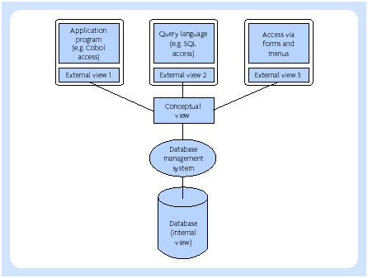
Database management

Slide 12
Why databases?
Increase data shareability
Increase data integrity
Increase speed of implementing applications
Ease data access by programmers and users
Increase data independence
Reduce program maintenance
Provide a management view
Improve standards

Slide 13
Data mining in SPSS approach
1. Business understanding:
  Statement of business objective
  Statement of data mining objective
  Statement of success criteria
2. Data understanding
  Explore the data and verify the quality
  Find outliers
3. Data preparation (this usually takes over 90% of the time)
  Data collection and assessment
  Consolidation and cleaning (table links, aggregation level, missing values, etc.)
  Data selection (active role in ignoring non-contributory data, dealing with outliers, use of samples, visualization, etc.)
  Transformations – create new variables

Slide 14
Data mining in SPSS approach (continue)
4. Apply models and algorithms
  Decision trees
  Neural networks
  Linear and logistic regressions
5. Analyse and evaluate results
  Classifications
  Clustering
  Associations
  Sequences
  How well do models perform on test data?
  Comparison of model results
6. Deployment
  Determine how the results need to be utilized
  Who needs to use them?
  How often do they need to be used?

